Slide 1


Join 2

Slide 2


List of Content
Types of Joins

Slide 3


Inner Join
Left Table
Right Table

Slide 4
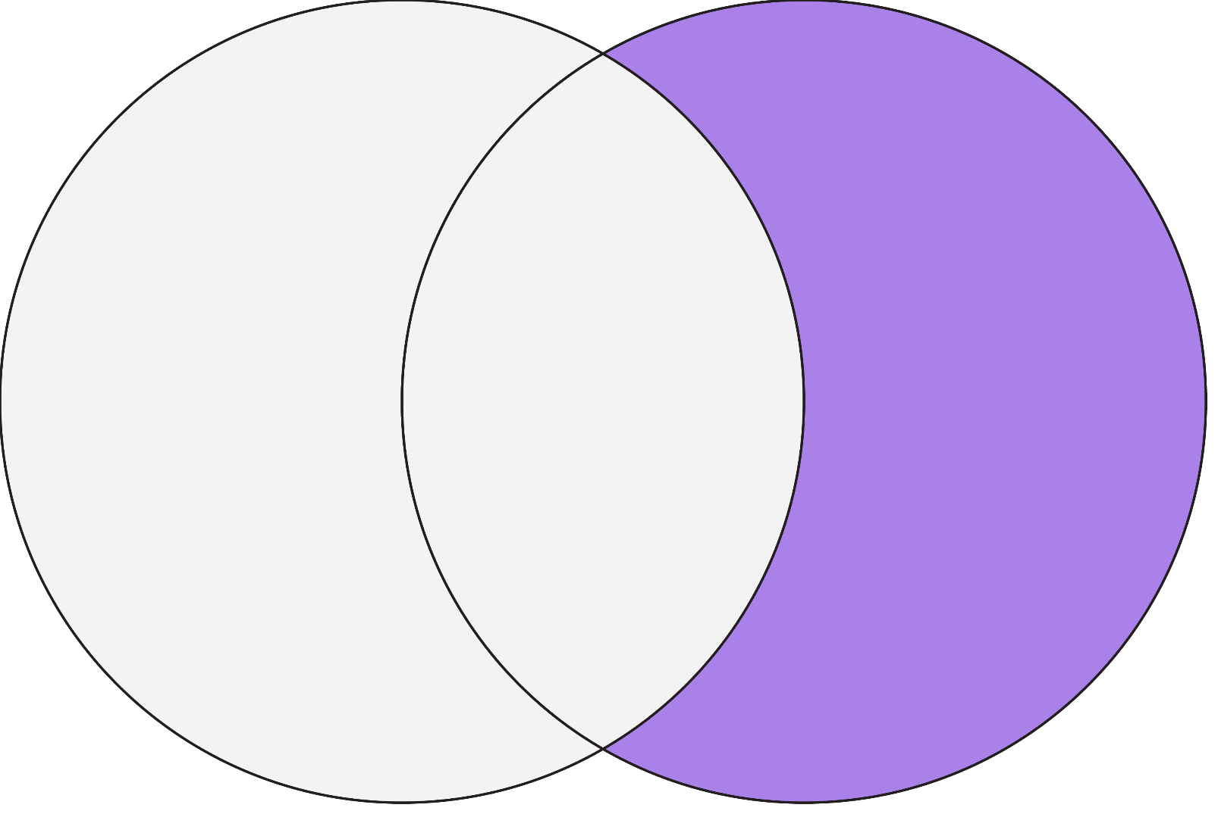
Left Join
Left Table
Right Table

Slide 5
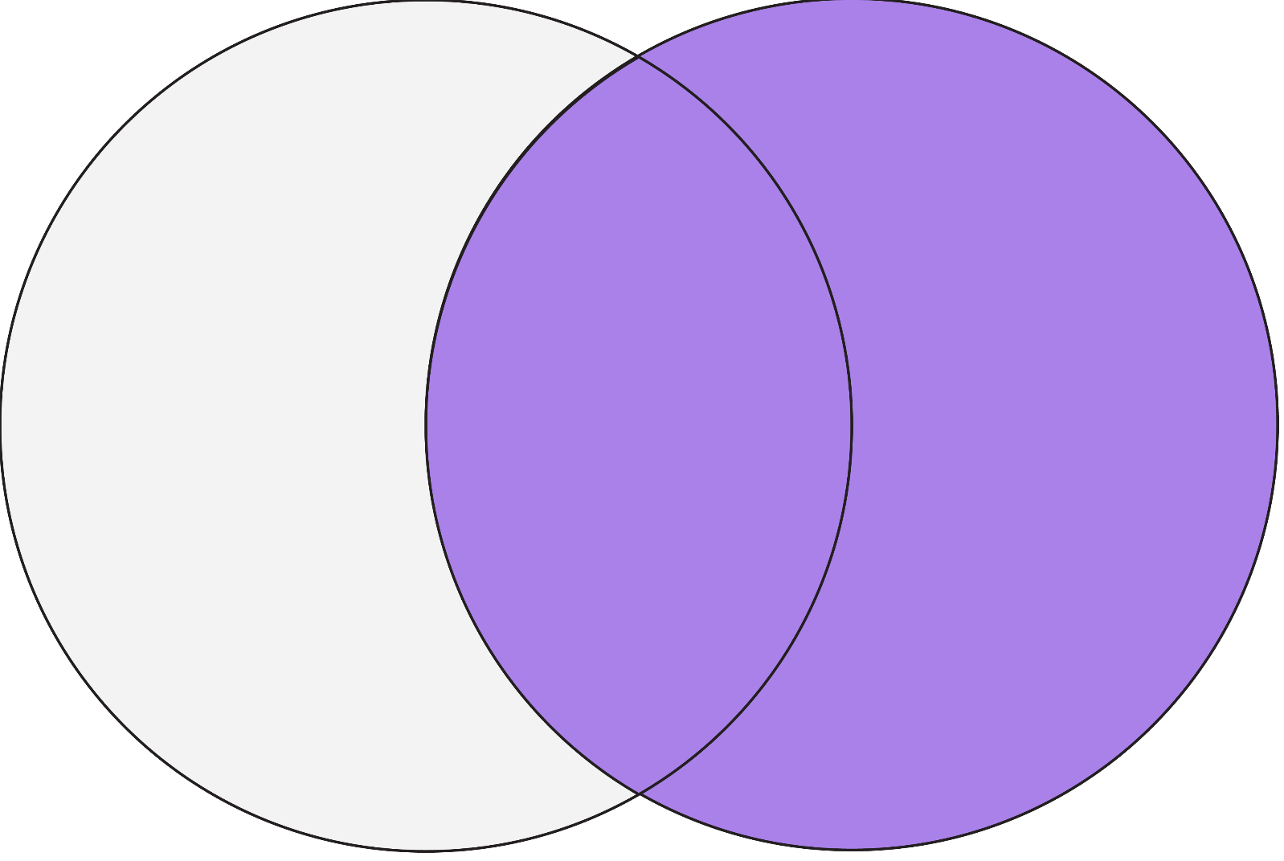
Right Join
Left Table
Right Table

Slide 6
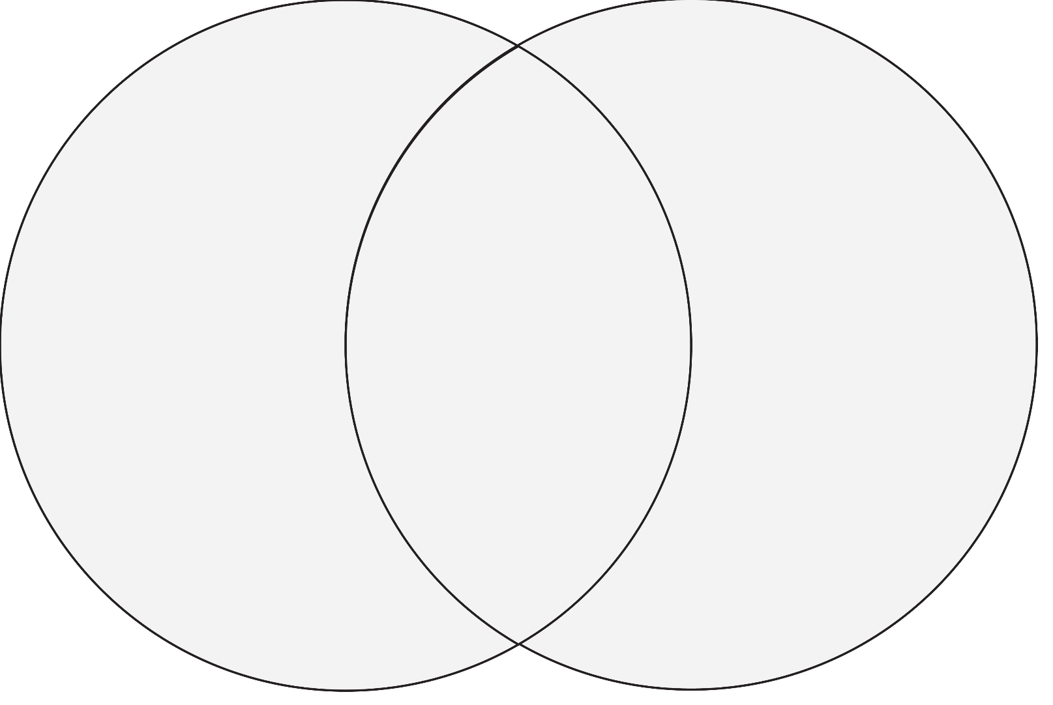
Full Join
Left Table
Right Table

Slide 7
THANK YOU

